Slide 1

Overview of the Canadian Energy Flow Account
Regional Seminar on the System of Environmental-Economic Accounts (SEEA) Central Framework in the Caribbean
February 6-7, 2014
Castries, Saint Lucia
Joe St. Lawrence
Statistics Canada

Slide 2
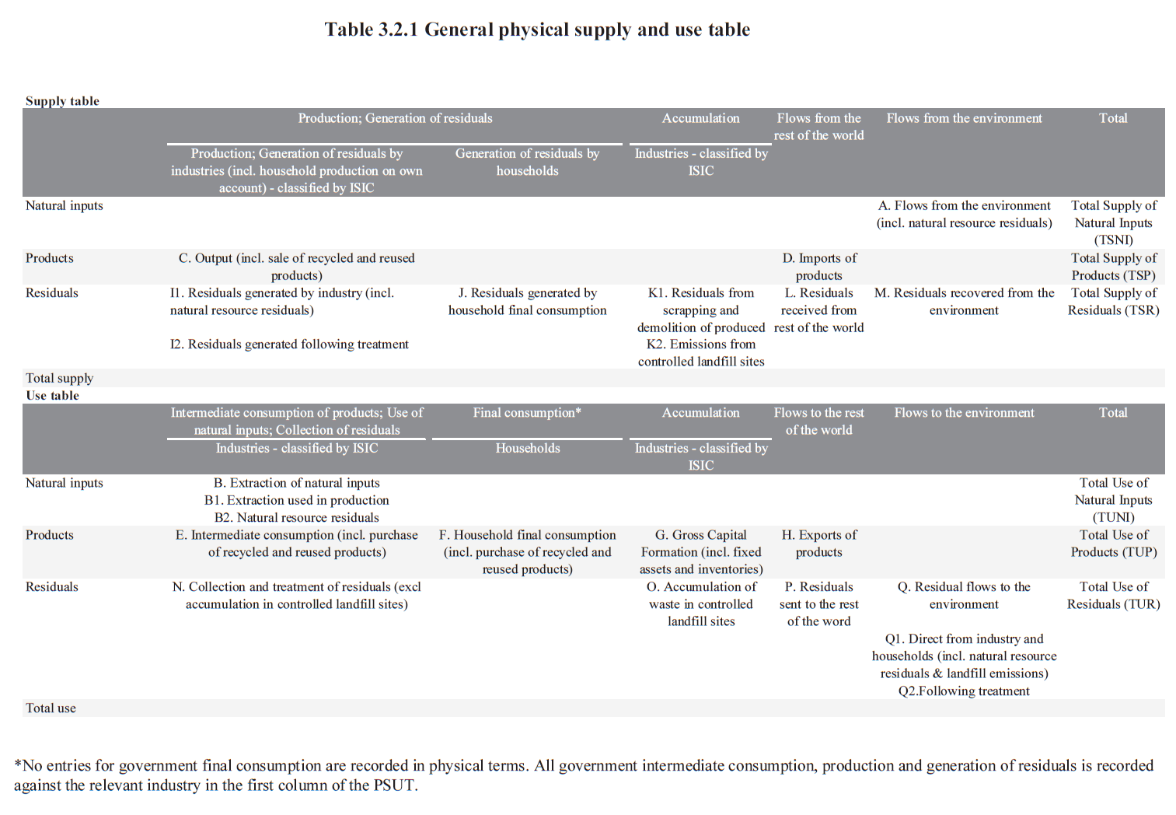
Physical Flow Accounts in the SEEA

Slide 3
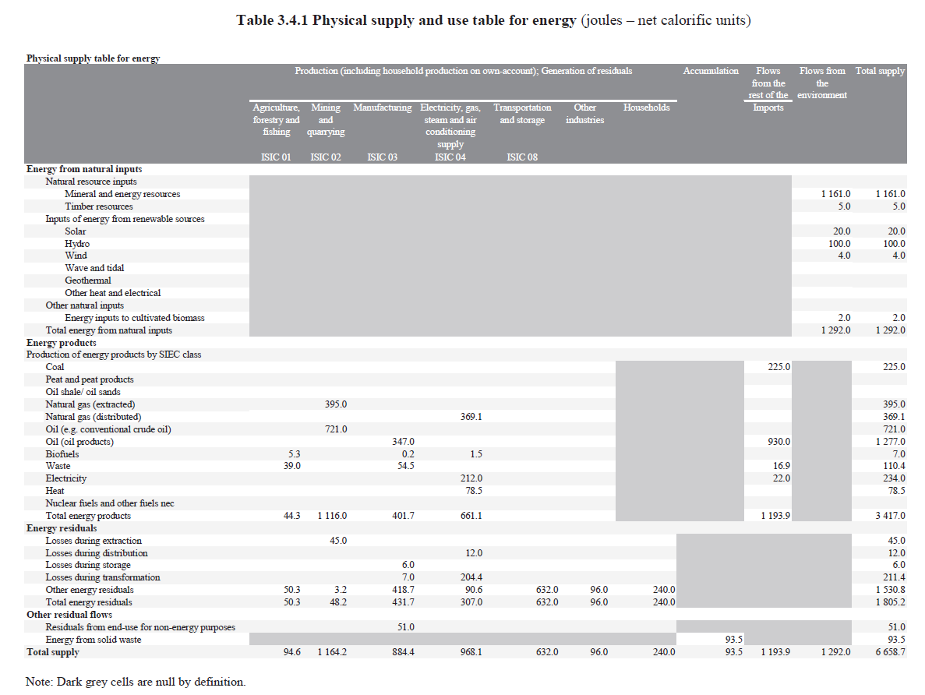
Energy Accounts in the SEEA: Supply

Slide 4
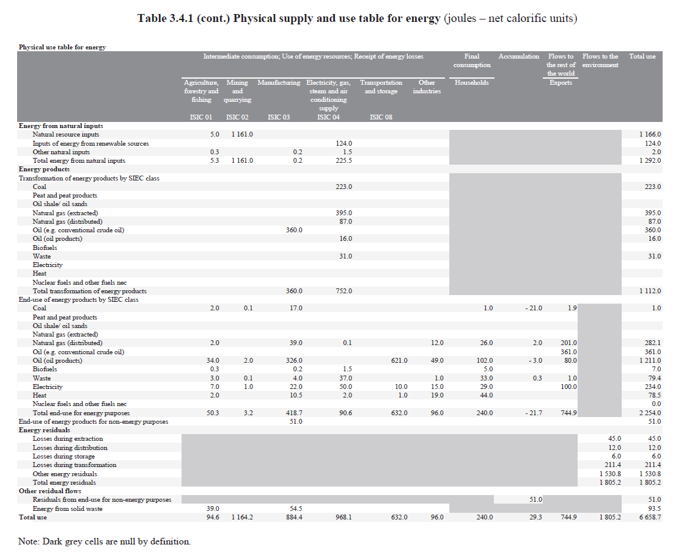
Energy Accounts in the SEEA: Use

Slide 5
Energy Accounts in Canada

Slide 6
Energy Accounts in Canada: Basic table

Slide 7
Overview of main data sources
Energy Supply and Demand Balances
Control totals, producer consumption, non-energy use etc.
Industrial Consumption of Energy Survey
Fuel use in manufacturing.
Annual Census of Mines
Fuel use in mining industries.
Transportation Surveys
Fuel use in transportation industries.
Input-output Tables
Fuel input expenditures users not surveyed above

Slide 8
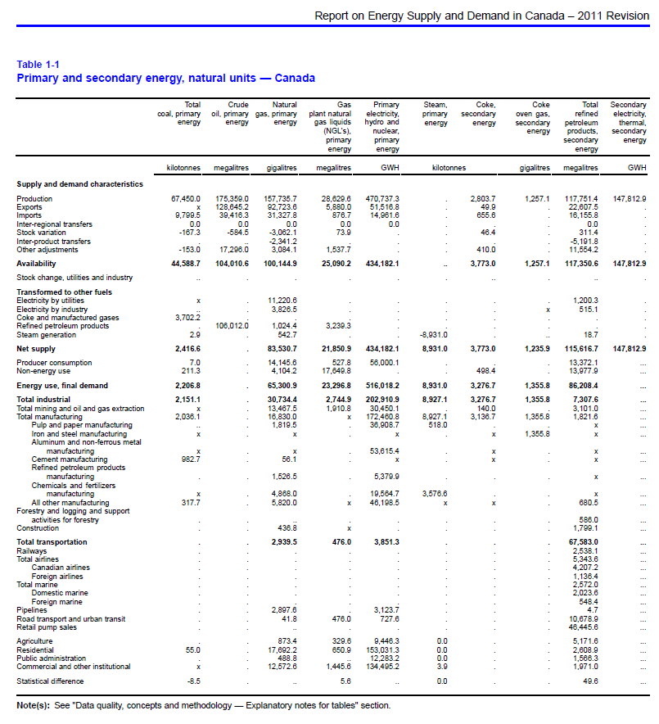
Energy Supply and Demand Balances

Slide 9
Energy Supply and Demand Balances: Source Surveys
Coke Monthly
Coal Monthly
Monthly Oil Pipeline Transport
Gas Utilities/Transportation and Distribution Systems (Monthly)
Monthly Refined Petroleum Products
Monthly Electricity
Natural Gas Disposition – Annual
End-Use of Refined Petroleum Products – Annual
Monthly Oil Pipeline Statement
Electricity Supply and Disposition – Annual
Electric Power Thermal Generating Station Fuel Consumption
Monthly Crude Oil and Natural Gas
Annual Industrial Consumption of Energy Survey
Annual Survey of Secondary Distributors of Refined Petroleum Products

Slide 10
Energy Account data sources
Manufacturing sector
Industrial consumption of energy survey
  terajoules (TJ) unit and NAICS classification
  non-energy and energy consumption
  coal, natural gas, electricity, HFO, LPG and coke
Petroleum report (provincial $/litre) and provincial Input Output expenditure
  derive number of litres bought and transform it into TJ
  diesel, motor gasoline and light fuel oil
~ 20% of total energy consumption

Slide 11
Energy Account data sources
Mining sector
Annual Census of mines
  conducted by Natural Resources Canada
  census of all mines for various fuel use (except coal)
  physical units and SIC classification
~ 2% of total energy consumption

Slide 12
Energy Account data sources
Various sectors
Report on Energy Demand and Supply
  Aggregated demand categories (no NAICS, SIC or IO structure), and energy and non-energy use.
  amounts are moved into their appropriate industries (non-energy, producer consumption and conversion)
Electric Power Thermal Generating Station Fuel Consumption Survey
  Own production of electricity
~ 40% of total energy consumption

Slide 13
Energy Account data sources
Transportation sector
Annual Air Carrier, Trucking, Passenger Bus and Urban Transit, and Rail surveys
  physical units and NAICS classification
~ 13% of total energy consumption

Slide 14
Energy Account data sources
Industries not surveyed above
Residual allocation based on expenditure and unused fuel availability
~ 25% of total energy consumption

Slide 15
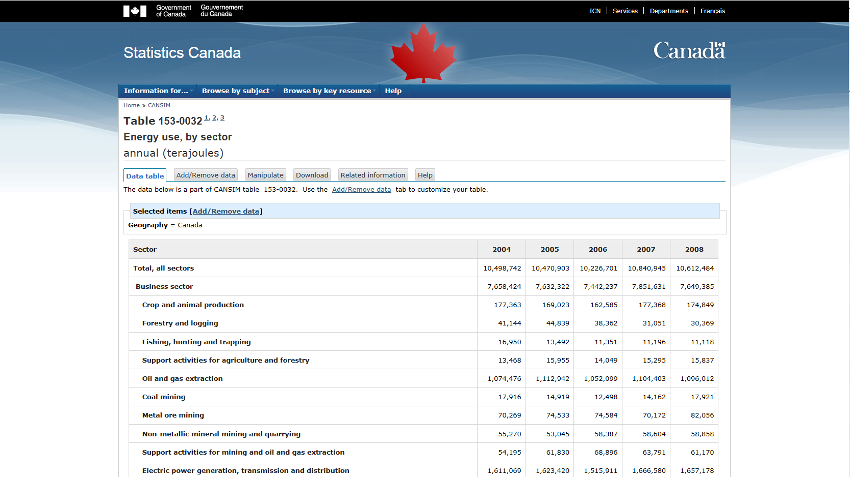
Final Output: Energy Use
Statistics Canada. Table 153-0032 - Energy use, by sector, annual (terajoules), CANSIM (database).
http://www5.statcan.gc.ca/cansim/a26?lang=eng&retrLang=eng&id=1530032&paSer=&pattern=&stByVal=1&p1=1&p2=50&tabMode=dataTable&csid=
Notes:
Confidentially pattern taken into account, on request, data per fuel are given.

Slide 16
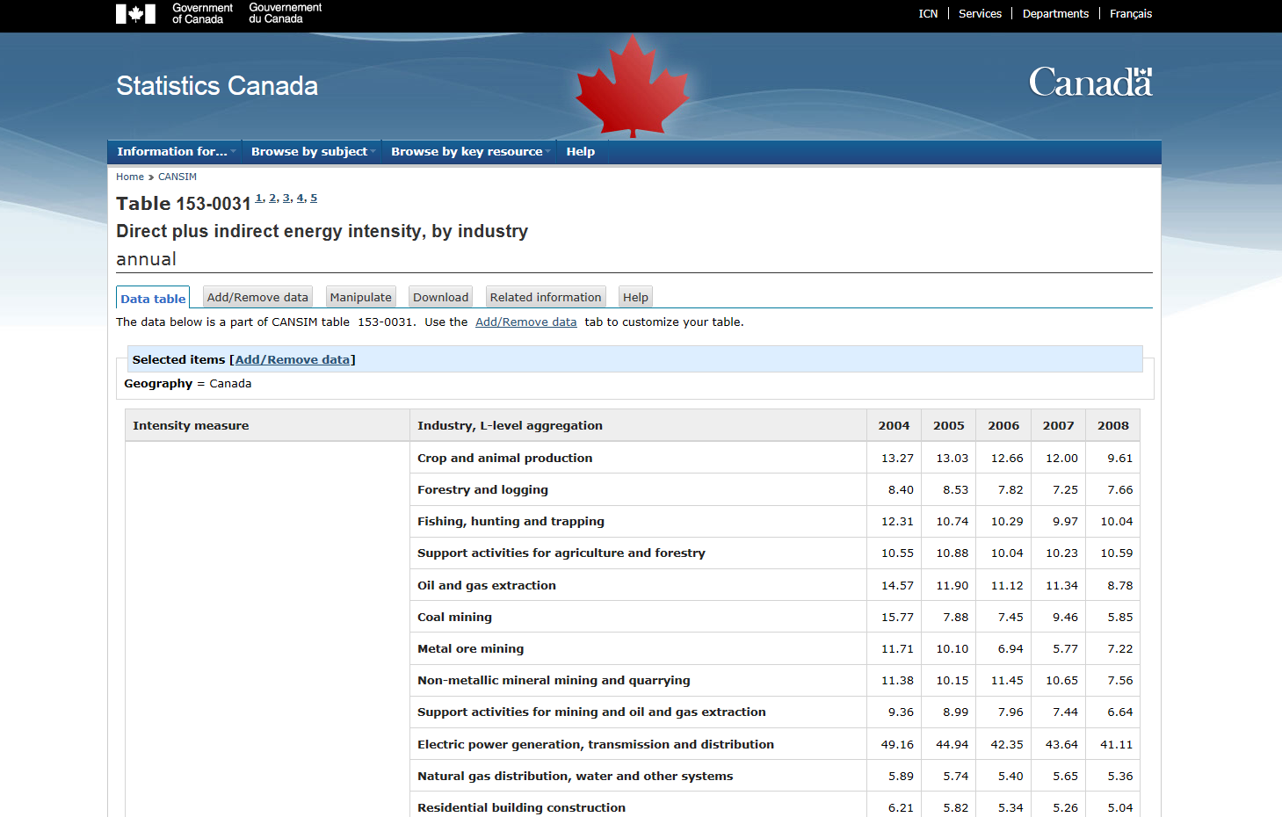
Final Output: Energy Intensity
Statistics Canada. Table 153-0031 - Direct plus indirect energy intensity, by industry,CANSIM (database).
http://www5.statcan.gc.ca/cansim/a26?lang=eng&retrLang=eng&id=1530031&paSer=&pattern=&stByVal=1&p1=1&p2=50&tabMode=dataTable&csid=

Slide 17
Energy Accounts Uses
Calculation of GHG emissions accounts
Impact analysis for International Trade
CGE modelling
Input-Output modelling
Energy use and intensity analysis
Etc…

Slide 18
Quality Control – Analysis
Coherence, time series, etc.
% changes in energy use from current year to previous year, per industry, per fuel.
Implicit price ($ paid/TJ) and intensity (TJ/$ output), per industry, per fuel.
GHG account output
Coherence analysis of the GHG account provides feedback to the energy account.
Bridge tables
to explain visually how we go from the total energy consumed to the energy flow account.

Slide 19
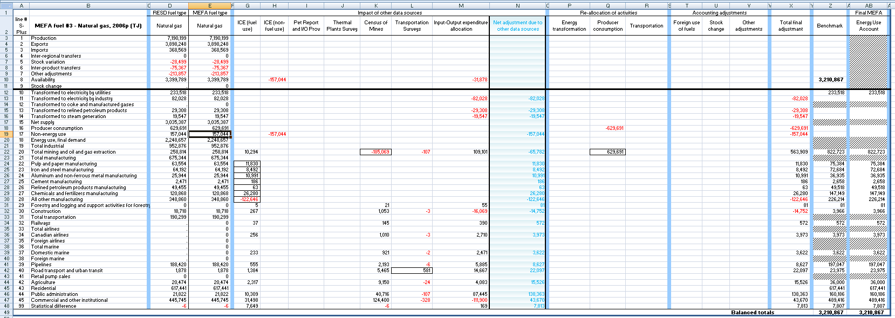
Quality Control – Bridge Tables

Slide 20
Challenges
Integration of data from many sources/providers
  Concepts and definitions may be different: be careful of double counting.
    Some data include foreign purchases of domestic fuel.
    Some data include producer consumption, some do not.
  Source data are not all collected using the same classification systems.
  Input data are not always in a dataset format.
Need to find new data sources
  Improve household and services sectors (less surveyed).
  Help for decision making when two sources give us different pictures.

Slide 21
Questions?
Joe St. Lawrence
Environment Accounts and Statistics | Comptes et statistique de l'environnement
R.H. Coats Building | Immeuble R.-H.-Coats / Floor | Étage 25 M
Statistics Canada | 100 Tunney's Pasture Driveway, Ottawa ON K1A 0T6
Statistique Canada | 100, promenade Tunney's Pasture, Ottawa ON K1A 0T6
Joe.St.Lawrence@statcan.gc.ca
Telephone | Téléphone 613-951-7709
Facsimile | Télécopieur 613-951-0634
Government of Canada | Gouvernement du Canada

